Slide 1
Complexity and Software

Slide 2
Inherent complexity of a software
Software development is a labor intensive task.
Simple system is different from
  Industrial strength software.
Focus is on design of a software.

Slide 3
Why software is inherently complex
Brooks mentioned
  The complexity of the problem domain
  The difficulty of managing the development process
  The flexibility possible through software
  The problem of characterizing the behavior of discrete systems
  Consequence of unrestrained complexity
    Software Crisis (late, over budget, deficient etc.)

Slide 4
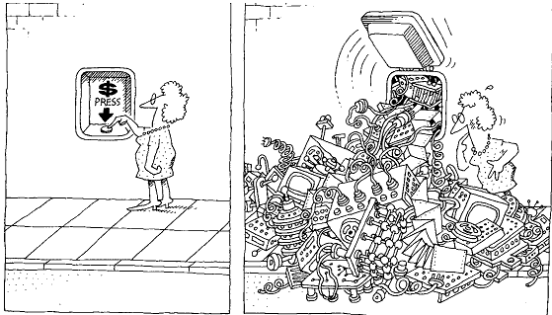
Inherent complexity of a software
The task of the software development team is to engineer the illusion of simplicity

Slide 5
Structure of complex systems
Examples:
  The structure of a personal computer
  The structure of plants and animals
  The structure of matter
  The structure of social institutions
  etc.

Slide 6
Attributes of a complex system
  Hierarchic structure
  Relative primitive
  Separation of concern
  Common patterns
  Stable intermediate forms

Slide 7
Organized and Disorganized Complexity
The Canonical Form of a Complex System
Bringing Order to Chaos
  Algorithmic and Object-Oriented Decomposition
  Role of abstraction
  Role of hierarchy

Slide 8
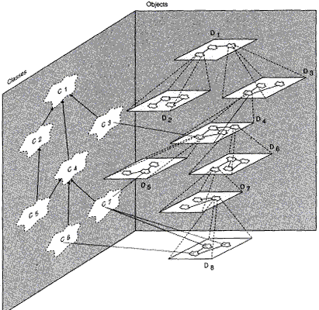
The Canonical Form of a Complex System

Slide 9
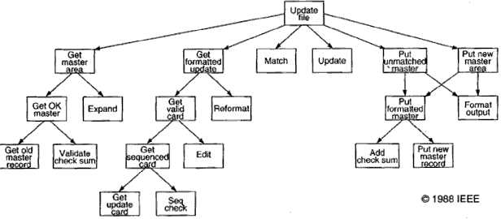
  Algorithmic Decomposition

Slide 10
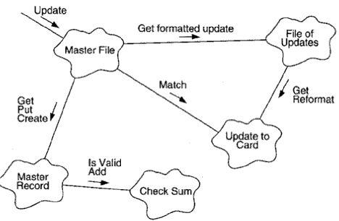
  Object-Oriented Decomposition

Slide 11
On designing complex systems
Engineering as a science and an art
It is a model building approach
Object-oriented analysis and design is the method that leads us to an object-oriented decomposition
Object oriented software development using UML

Slide 12
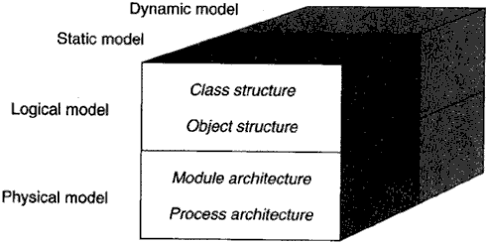
The Models of Object-Oriented Development

Slide 13
Object Oriented Analysis and Design
Object-oriented analysis and design (OOAD) is the method that leads us to an object-oriented decomposition.
OOAD is a combined approach to problem analysis and designing the solution.
The OOAD method is strongly supported by a sound engineering science called modeling.
A model is an abstract representation of a system that enables software engineers to understand the problem of an application and to design the solution for the system.
Modeling supports both application domain and the solution domain.
The application domain represents the real world situation of the system.
The solution domain represents the system design specifications that lead to the system implementation.

